Slide 1





CS 794: Project Lab Group 6 ‘DealOfTheDay’ Android App
Supervised by Prof. Souvik Biswas
Department of Computer Science and Engineering Neotia Institute of Technology, Management & Science November 2015 7th Semester 2013-2017 Batch
By:
Arindam Ganguly (14400113008)
Niladri Sekhar Basu (14400113017)

Slide 2
Contents:
Project Overview
Background Study
Analysis & Solution
Design
Target vs. Achievement – 7th Semester
Plan of work – 8th Semester
Conclusion

Slide 3
Project Overview:
To build an Android Application named DealOfTheDay which will provide user the best deals on various items on a real time basis.
Maintain a online database and fetch data from it.

Slide 4
Background Study : Android
Introduction to Android Studio: Android Studio is the official Integrated Development Environment (IDE) for Android app development. On top of IntelliJ's powerful code editor and developer tools, Android Studio offers even more features that enhance your productivity when building.
Basic Framework and Project Structure
Activity Lifecycle
Application Components and different View items
Several Data Storage Options

Slide 5
Background Study: Firebase
A cloud-hosted NoSQL database. Data is stored as JSON, synced across connected devices in milliseconds, and available even when app goes offline.
Production-grade hosting for developers. Deploy Web and mobile Web apps to a global content-delivery network (CDN) with a single command.

Slide 6
Background Study: Scraping
Web Scraping (also termed Screen Scraping, Web Data Extraction, WebHarvesting etc) is a technique employed to extract large amounts of data from websites whereby the data is extracted and saved to a local file in your computer or to a database in table (spreadsheet) format.
Beautiful Soup sits atop an HTML or XML parser, providing Pythonic idioms for iterating, searching, and modifying the parse tree.
First, the document is converted to Unicode, and HTML entities are converted to Unicode characters.

Slide 7



Analysis & Solution
The following are required for DealOfTheDay which is being developed to provide the best deal’s of the market and to analyze the latest shopping trends:
Language Used: Java 8, Python 3.
Framework: Android
Hardware Used: i5 4200U, 8 GB Ram
OS: Windows 8.1 Pro
IDE used: Android Studio 2.2.2, PyCharm 5x

Slide 8
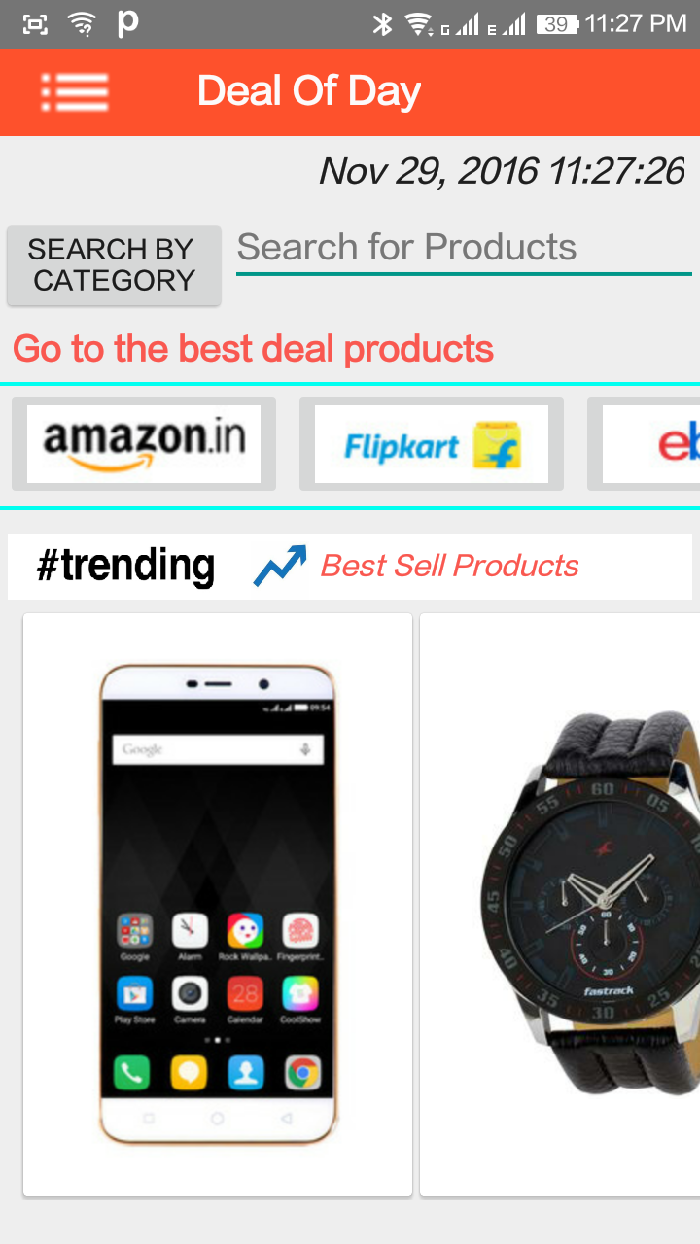
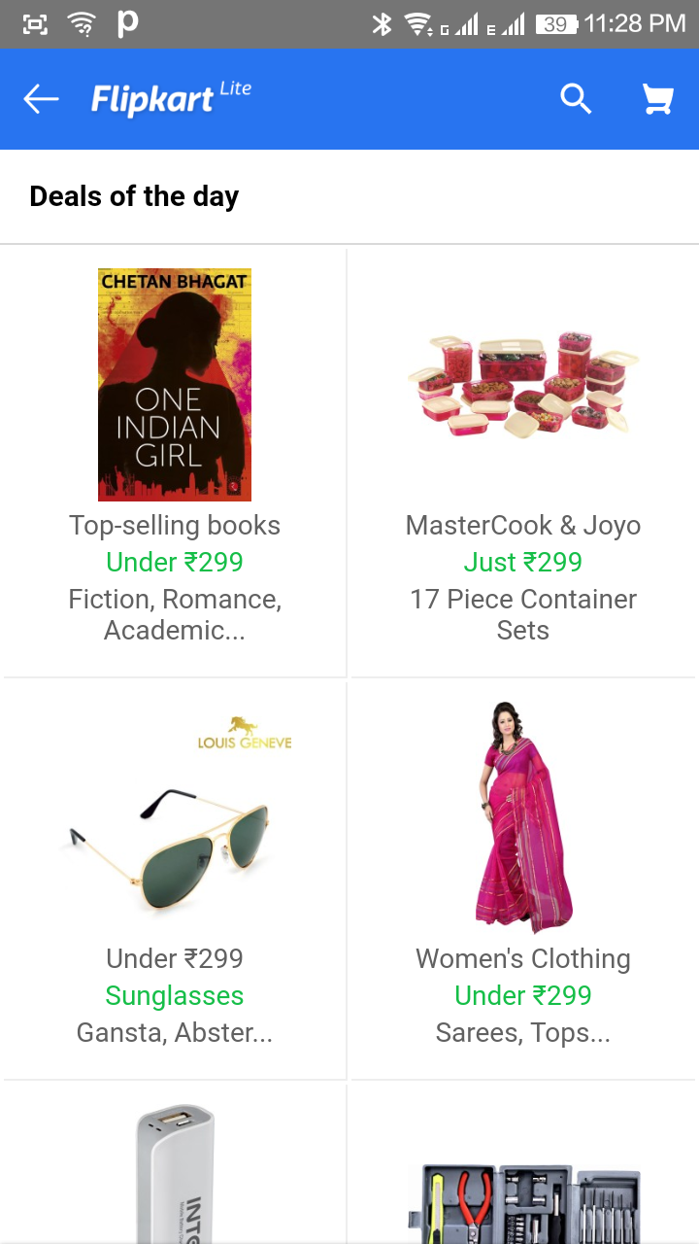
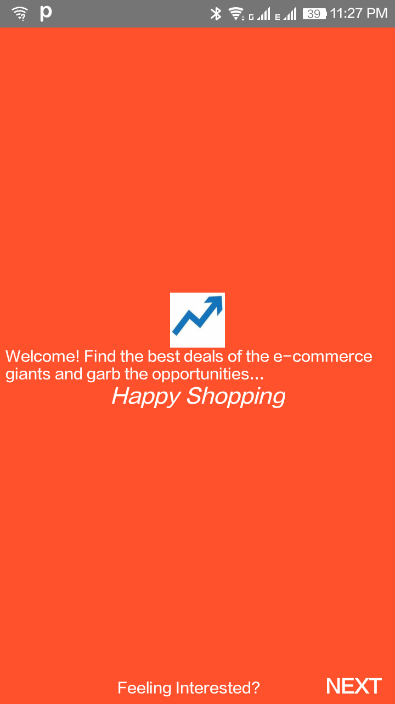
Design

Slide 9
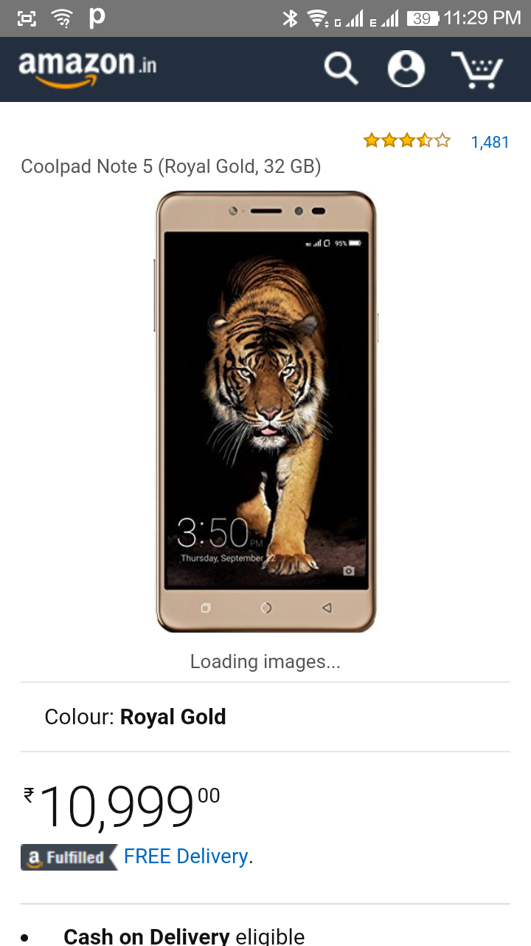
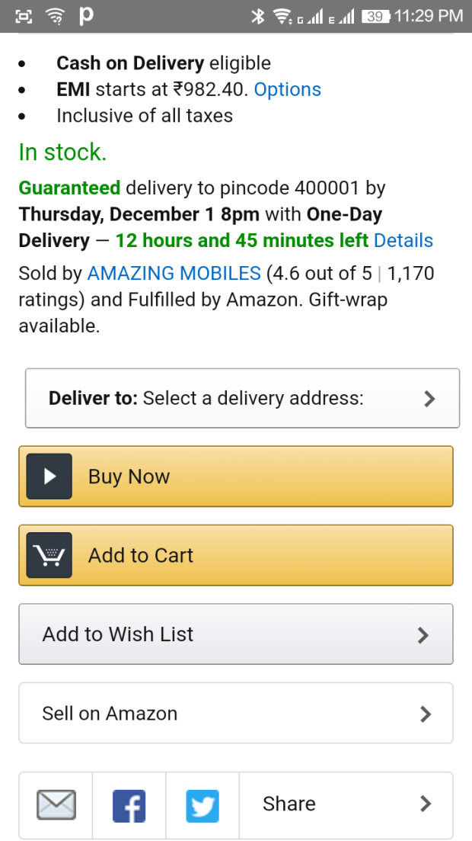
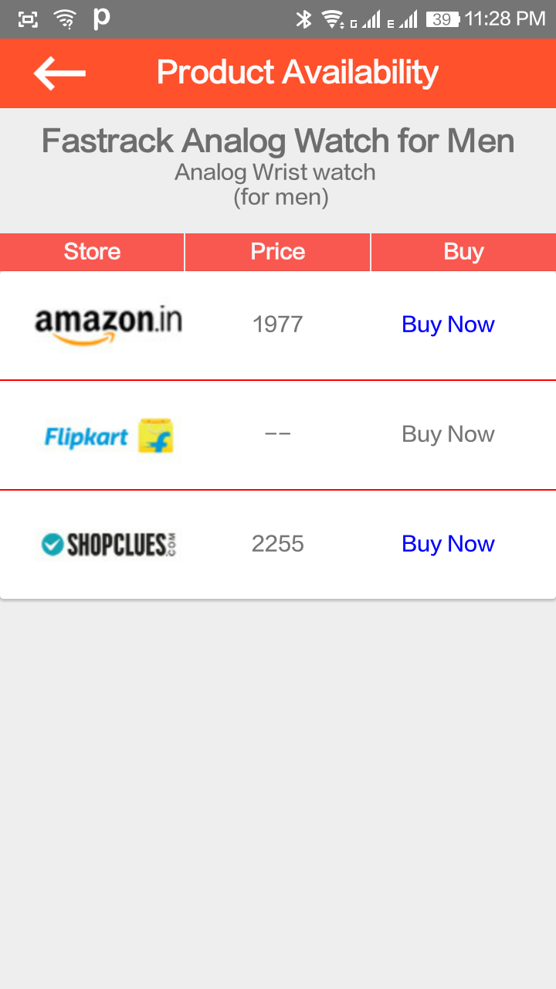
Design

Slide 10
Target vs Achievement: 7th Semester
Target Set:
To build an Android Application named DealOfTheDay which will provide user the best deals on various items on a real time basis. Also User will be able to find products by name and category.
A strong UI Design and good User Experience
Target Achieved:
Storing the data in a server.
Fetching the data from online database and displaying the price from the app.
Displaying the best deals of Amazon and Flipkart.

Slide 11
Plan of work: 8th Semester
Scraping data from some major shopping websites like Amazon, Flipkart etc. and store the data (If legally permissible).
To sync the online database from scraped data.
UI Improvements and category wise search implementations.
Few additional features implementing.

Slide 12
References:
https://firebase.google.com/docs/
https://developer.android.com/studio/intro/index.html
http://stackoverflow.com/questions/tagged/android
https://docs.python.org/3/tutorial/
https://www.crummy.com/software/BeautifulSoup/bs4/doc/

Slide 13
Thank You!!

